Slide 1
Windows Tech Series Cloud Solution Integration
Speaker 1
Title
Speaker 2
Title

Slide 2
Agenda
Day | Day 1 Deployment | Day 2 Management | Day 3 Security | Day 4 Windows for CSP
 |  |  |  | Deployment | Management | Security
Synopsis | Module 1 – Introduction | Module 1 – Base System Setup | Module 1 – Analysis Of Common Threats | Module 1 – Windows for SMB Partners
 | Module 2 – Applications & Updates | Module 2 – Configuration | Module 2 – Hardening Windows | Module 2 – Windows Ent. Subscription
 | Module 3 – Windows as a Service (WaaS) | Module 3 – Managing Client Devices | Module 3 – Advanced Threat Protection | Module 3 – Deployment
 | Module 4 – Browsers & Internet Security | Module 4 – Advanced management options I | Module 4 – Information Security (RMS/EDP) | Module 4 – Managing Updates
 | Module 5 – Secure Boot & Device Guard | Module 5 - Advanced management options II | Module 5 – Internet Security

Slide 3
Part 4 – Advanced Client Management
Create Provisioning Package with ICD
Apply PPKG in OOBE
Apply PPKG while user is already logged on
Conditional access
Windows Update for Business in WSUS

Slide 4
When to use Provisioning
Configure a BYOD or Employee-owned device to Corporate Standards
Automate enrollment into MDM, Domain or Azure Active Directory
Ensure compliance and security BEFORE the device is enrolled
Notes:
First bullet – can be a new machine or BYOD phone

Slide 5
How it works
Windows Imaging and Configuration Designer creates a Provisioning Package
A package is a bundle of settings, profiles and file assets
Settings
Profiles
Assets
Provisioning Package (PPKG)
Asset binaries can be included in the package or referenced by URL
Notes:
Settings are simple policies – like minimal password length or disabling a camera
Profiles – Wi-Fi profile, VPN, Email
Assets are files required to make your configuration work, that includes wallpapers, certificates, applications, offline materials.

Slide 6
What can be Provisioned
Initial Setup
Edition Upgrade
Certificates
Connectivity Profiles
Management Enrollment
Universal Windows Apps
Win32 Applications
Scripts
Enterprise Policies
Offline content
Browser Settings
Start Menu Customization
Assigned Access
Notes:
Quite a few things. As you can see, many can be also provisioned through MDM but several capabilities are exclusive for provisioning.
One example would be

Slide 7



Under the Hood
MDM (Intune)
Provisioning
EAS
ConfigMgr
Service/Server
Device/OS
MDM Client
Provisioning Engine
EAS Client
WMI Bridge
Common Device Configurator
WMI providers
MDM Configuration Service Providers (CSP’s)
Notes:
Let’s take a look under the hood
Provisioning is using the same management surface that is exposed through Mobile Device Management + abilities exclusive used for provisioning
The key difference is that MDM interactive and the server can get feedback
Examples of configuration service providers

Slide 8
Management Labs Module 04-01: Create Provisioning Package with ICD Module 04-02: Apply PPKG in OOBE Module 04-03: Apply PPKG while user is already logged on Module 04-04: Installation of the Windows 10 Branch on a client

Slide 9
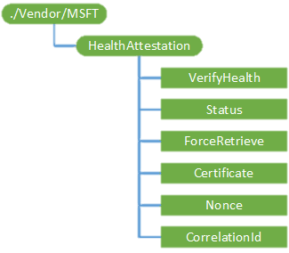
Condition Access / Health Attestation Need access? Prove you’re healthy
ENROLLMENT
UNENROLLMENT
INVENTORY
REMOTE ASSISTANCE
DEVICE CONFIGURATION & SECURITY
APPLICATION MANAGEMENT
MDM evaluates compliance
HealthAttestation CSP Device health attestation
Provable Health
Compliance Rules
Is device patched?
Is Firewall enabled?
Is Antivirus & real time protection enabled?
Company Resources
Documents
Documents
MDM & Windows Attestation Service
Here is my proof
4
Access please
5
1
3
Prove to me you are healthy
You’re in
2
Email
2
Email
Access please
1
Notes:
In the windows 10 timeframe, with Azure AD based conditional access, access to Azure based apps can be controlled based on the device compliance state. The compliance of the device is evaluated by the MDM based on a number of device attributes.
One of these key attributes is the hardware based device health attestation state.
Today we have the ability to detect jailbreak for some of the non windows devices out there. You can think of Device health attestation state for Windows 10 as something like this but provable in hardware.
We have a cloud based Windows health attestation service that is already up and running that Windows 10 devices will talk to, to be certified as healthy.

Slide 10
Management Labs Module 04-05: Conditional access Module 04-06: Only show Private store in store App (TBD!!!)

Slide 11
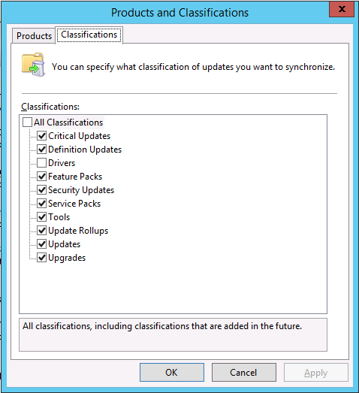
Windows Server Update Services
Enabling upgrades
Updated to support Windows 10 feature upgrades, including upgrades from down-level OSes
Requires WSUS 4.0 (Windows Server 2012 or above) with KB3159706
See
http://blogs.technet.com/b/wsus/archive/2015/12/04/important-update-for-wsus-4-0-kb-3095113.aspx for an important note
Windows 10 Enterprise has been published
Notes:
Its promise to business is to keep devices secure, up to date, cut costs.
As of November companies have ability for It to create “distribution rings” phasing updates for different user groups and create “maintenance windows” as well as the ability to defer updates and take advantage of peer-to-peer caching to save network bandwidth during updates
You can see an example of the policy setting UI here, for IT - setting policies for GP/ MDM tools to manage the pace of updates via WU for Business while having it take care of device updating for your organization

Slide 12
Management Labs Module 04-07: Windows Update for Business in WSUS

